Slide 1
React JS

Slide 2
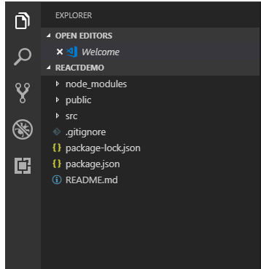
React Js Folder Structure
The React application automatically creates required folders, as shown below.

Slide 3
node_modules
This folder will contain all react js dependencies.
.gitignore
This file is used by source control tool to identify which files and folders should be included or ignored during code commit
package.json
This file contains dependencies and scripts required for the project.

Slide 4
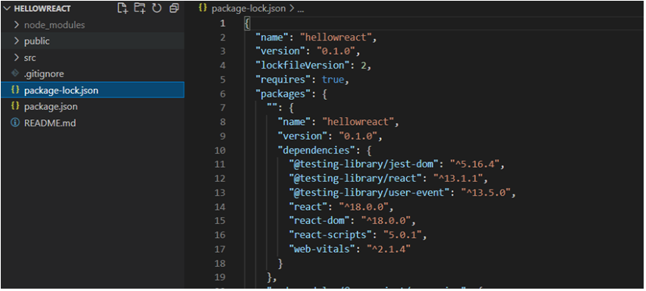

Slide 5
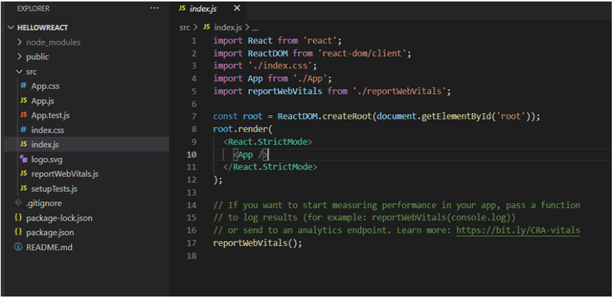
Src folder
src is one of the main folder in react project.

Slide 6
Index.js
index.js is the file that will be called once we will run the project.
App.js
App.js is a component that will get loaded under index.js file. If we do any change in app.js file HTML component and save it it will reflect in localhost://3000

